Slide 1
Redesigning a restaurant website using UD
(https://firstslice.org/)
Student Name:

Slide 2
introduction
This presentation will be evaluation of an existing website (https://firstslice.org/), and a documentation of how to make it more accessible.
The existing website lacks accessibility, this presentation is aimed at redesigning the site following the accessibility guidelines.
The main areas of focus in this presentation will be:
      General website layout
      Text
      Images and video
      Color
      Language

Slide 3
1. GENERAL LAYOUT
This section is concerned with examining the layout of the existing website, and finding ways of making it accessible

Slide 4
introduction
The design and flow of the current website is not easy to use.
The current layout has too many elements on the screen in terms of text.
The layout could be simplified by reducing the number of elements on each page.
The website also lacks a clear visual hierarchy.
There is however, use of consistent style across the pages.

Slide 5
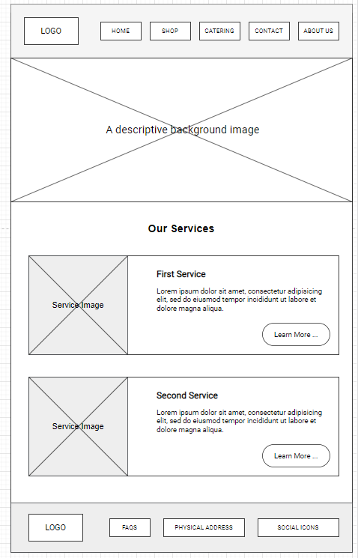
Redesigned solution
In an effort to make it more accessible, I have simplified the layout to make it easy to use, and also accessible, following UD principles
Key points:
Reduced number of navigation items
Visual hierarchy implemented
Use of “white space”
Use of descriptive images

Slide 6
2. text
This section looks at the use of text, and how to make it more accessible.

Slide 7
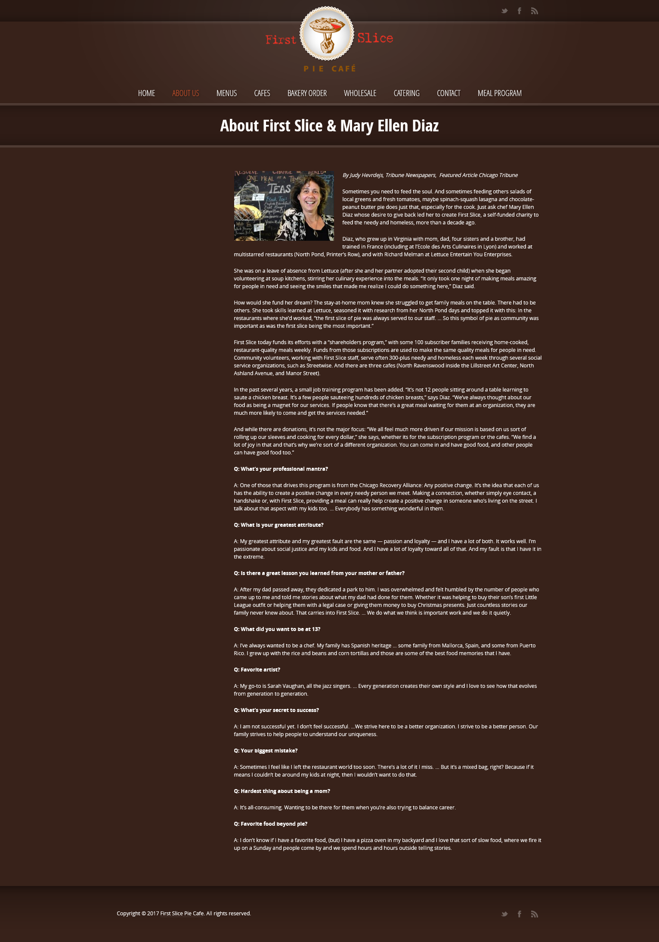
introduction
The current website has too much text, making it difficult to read
Also, there is no way to increase the font size to make it more readable for people who are visually impaired.
The text hierarchy has not been adhered to.
Some sections have very little contrast making text unreadable.

Slide 8
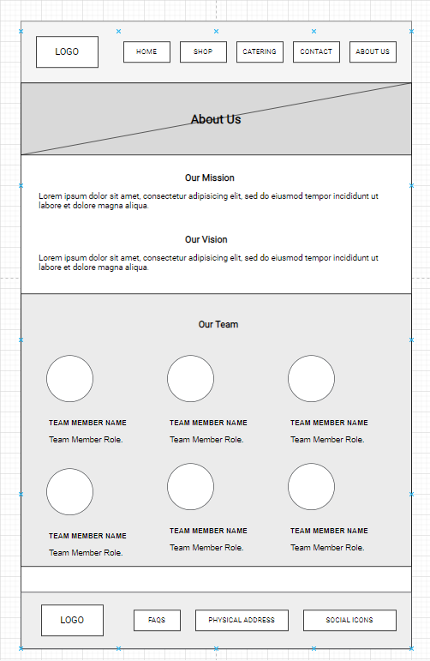
Redesigned solution
Key points:
Reduce text on the pages
Use a more readable font
Adhere to the visual hierarchy – the high level headings are h1, while the lowest level headings are h6

Slide 9
3. Images and video
This section is about making images more accessible

Slide 10
Introduction
The current website can be made more accessible by adding alternate text to images through the ‘alt’ tag
Captions and taglines can also be added to pictures to improve accessibility.
The quality of images could be enhanced

Slide 11
4. Color
This section is all about making the current website more accessible using color

Slide 12
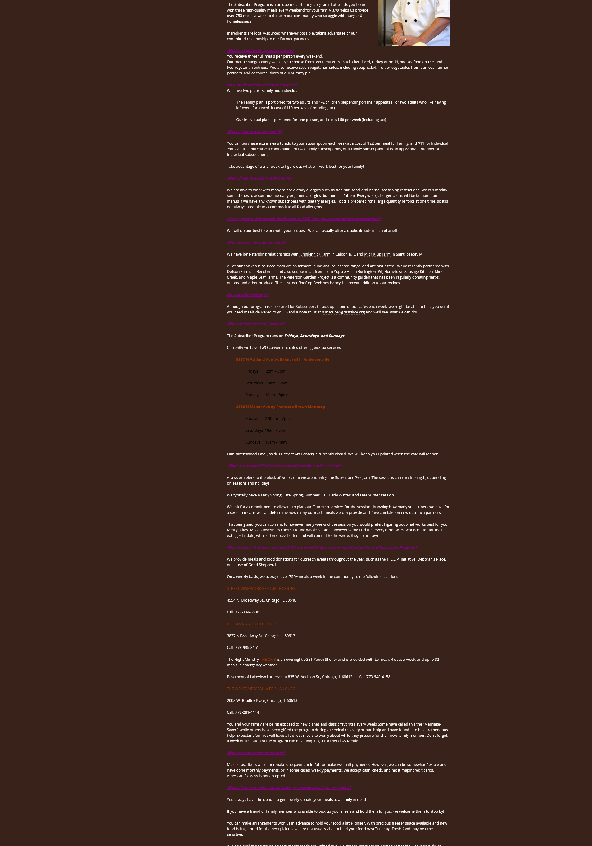
Introduction
The current website is monotonous.
The contrast between the background and foreground color could also be improved
Color could also be used to distinguish call to action buttons on the website to make it more accessible

Slide 13
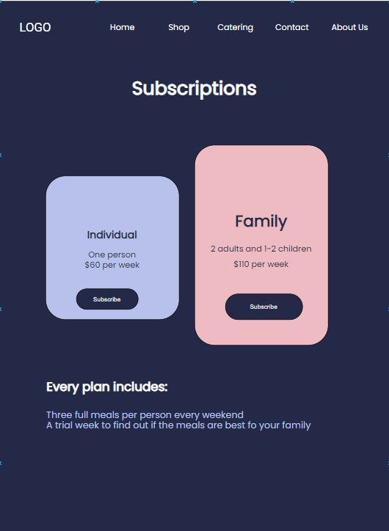
Redesigned solution
Key points
Simplified design
Use of color for distinguishing a call to action from normal content
Use of clear contrast to communicate the message

Slide 14
5. Language
This section examines how to use language to improve accessibility

Slide 15
Introduction
The current website does not allow the user to change language to their preferred one
Adding internationalization to the website will make it more accessible and easier to use across different regions of the world.
This way, a user can easily choose the language they desire to use on the website, or even translate.

Slide 16
Thank you!

